Slide 1
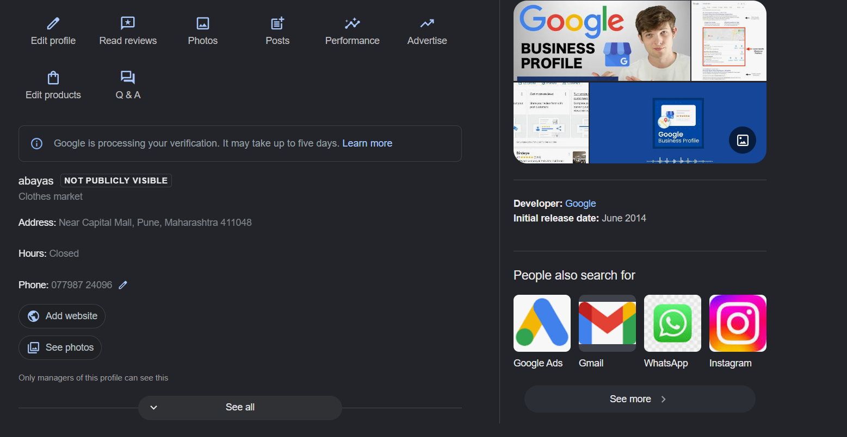
Google my business

Slide 2
www.alhayathemodesty.com (updating products)
al._.haya._.abayas (Instagram)
Al haya (facebook)
Al haya abayas (pinterest)
Al haya (youtube)

